Slide 1

GLOBAL CITIZEN LEADERSHIP
Submitted to :
Dr. Vandana Pawar
Prof. Tanushree B.

Slide 2
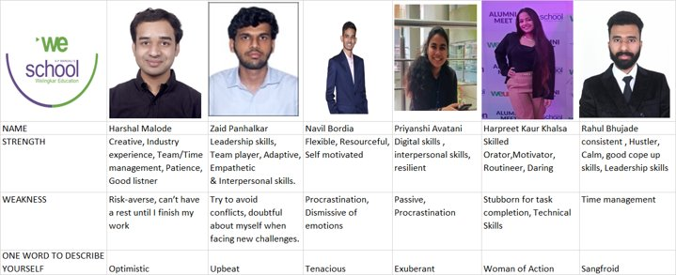

Slide 3
Mission
To identify and analyze the barriers preventing women from participating in the workforce and to develop and implement solutions to eliminate these barriers and promote gender equality in the workplace.
Vision
A world where women have equal opportunities to participate in the workforce, are respected and valued for their contributions, and are able to reach their full potential in their careers.

Slide 4
Problem Statement : Analyse What are the barriers of Women Employment in Rural India ( Team Mejora )

Slide 5
Barriers of women employment in rural India
The Government of India collects data on various aspects of women's employment in rural areas through various sources such as the Census of India and the National Sample Survey Organization (NSSO).
According to the census data, the female workforce participation rate in rural India was 31.2% in 2011, which is significantly lower than the male workforce participation rate of 82.2%.

Slide 6
THE BARRIERS TO WOMEN’S EMPLOYMENT IN RURAL INDIA
Lack of education and skills: Many women in rural areas do not have the education or skills necessary to secure formal employment
Social and cultural norms: Traditional gender roles and cultural norms can limit women's opportunities for employment, particularly in more conservative communities
Lack of infrastructure and transportation: Rural areas often lack the infrastructure and transportation necessary to support formal employment, making it difficult for women to access job opportunities
Limited access to credit and financial resources: Women in rural areas may have limited access to the credit and financial resources necessary to start or expand a business

Slide 7
THE BARRIERS TO WOMEN’S EMPLOYMENT IN RURAL INDIA
Time-consuming household responsibilities: Many women in rural areas are primarily responsible for household chores and childcare, which can limit their ability to participate in paid work
Limited access to decision making power and ownership of property and assets, this limits their ability to access credit and financial resources for starting or expanding a business
Limited access to technology and digital infrastructure, this limits their ability to access information and opportunities for education and employment
Inadequate healthcare facilities and services, this affects their ability to take care of their health and participate in paid work

Slide 8
LINKAGE TO SUSTAINABLE DEVELOPMENT GOALS
No Poverty - Women's unemployment in rural areas can lead to poverty and exacerbates the cycle of poverty in these communities.
Peace, Justice and Strong Institutions - Addressing the barriers to women's employment will help promote gender equality and improve the rule of law in rural areas, thereby promoting peace and stability.
Gender Equality - Women's employment opportunities are often limited in rural areas due to gender-based discrimination and unequal access to education and training.
Decent Work and Economic Growth - Women's employment plays a crucial role in the economic growth and development of rural areas. Addressing the barriers to women's employment will help promote sustainable economic growth in these areas.
Reduced Inequalities - Addressing the barriers to women's employment will help reduce income inequalities and improve the standard of living for women in rural areas.

Slide 9
STAKE HOLDER MAPPING
Women in rural areas: The primary stakeholders, who face the barriers to employment and are affected by them
Families: The families of women in rural areas are also affected by the lack of employment opportunities for women and the resulting poverty and socio-economic disadvantage
Employers: Employers in rural areas, particularly in the informal sector, may have a vested interest in increasing the number of women in the workforce, as they can offer a reliable and cost-effective source of labor
Government: The Government of India is responsible for creating the policies and programs that address the barriers to women's employment in rural areas, and is also responsible for monitoring and evaluating their effectiveness

Slide 10
STAKE HOLDER MAPPING
NGOs and civil society organizations: NGOs and civil society organizations play an important role in advocating for women's rights and providing support services to help women overcome the barriers to employment
Private sector companies: Private sector companies operating in rural areas have a vested interest in improving the socio-economic conditions in the region, as it can enhance the quality of life and improve their reputation
International organizations: International organizations such as the United Nations and the World Bank are involved in promoting women's empowerment and gender equality globally, and may provide support and resources to address the barriers to women's employment in rural India

Slide 11
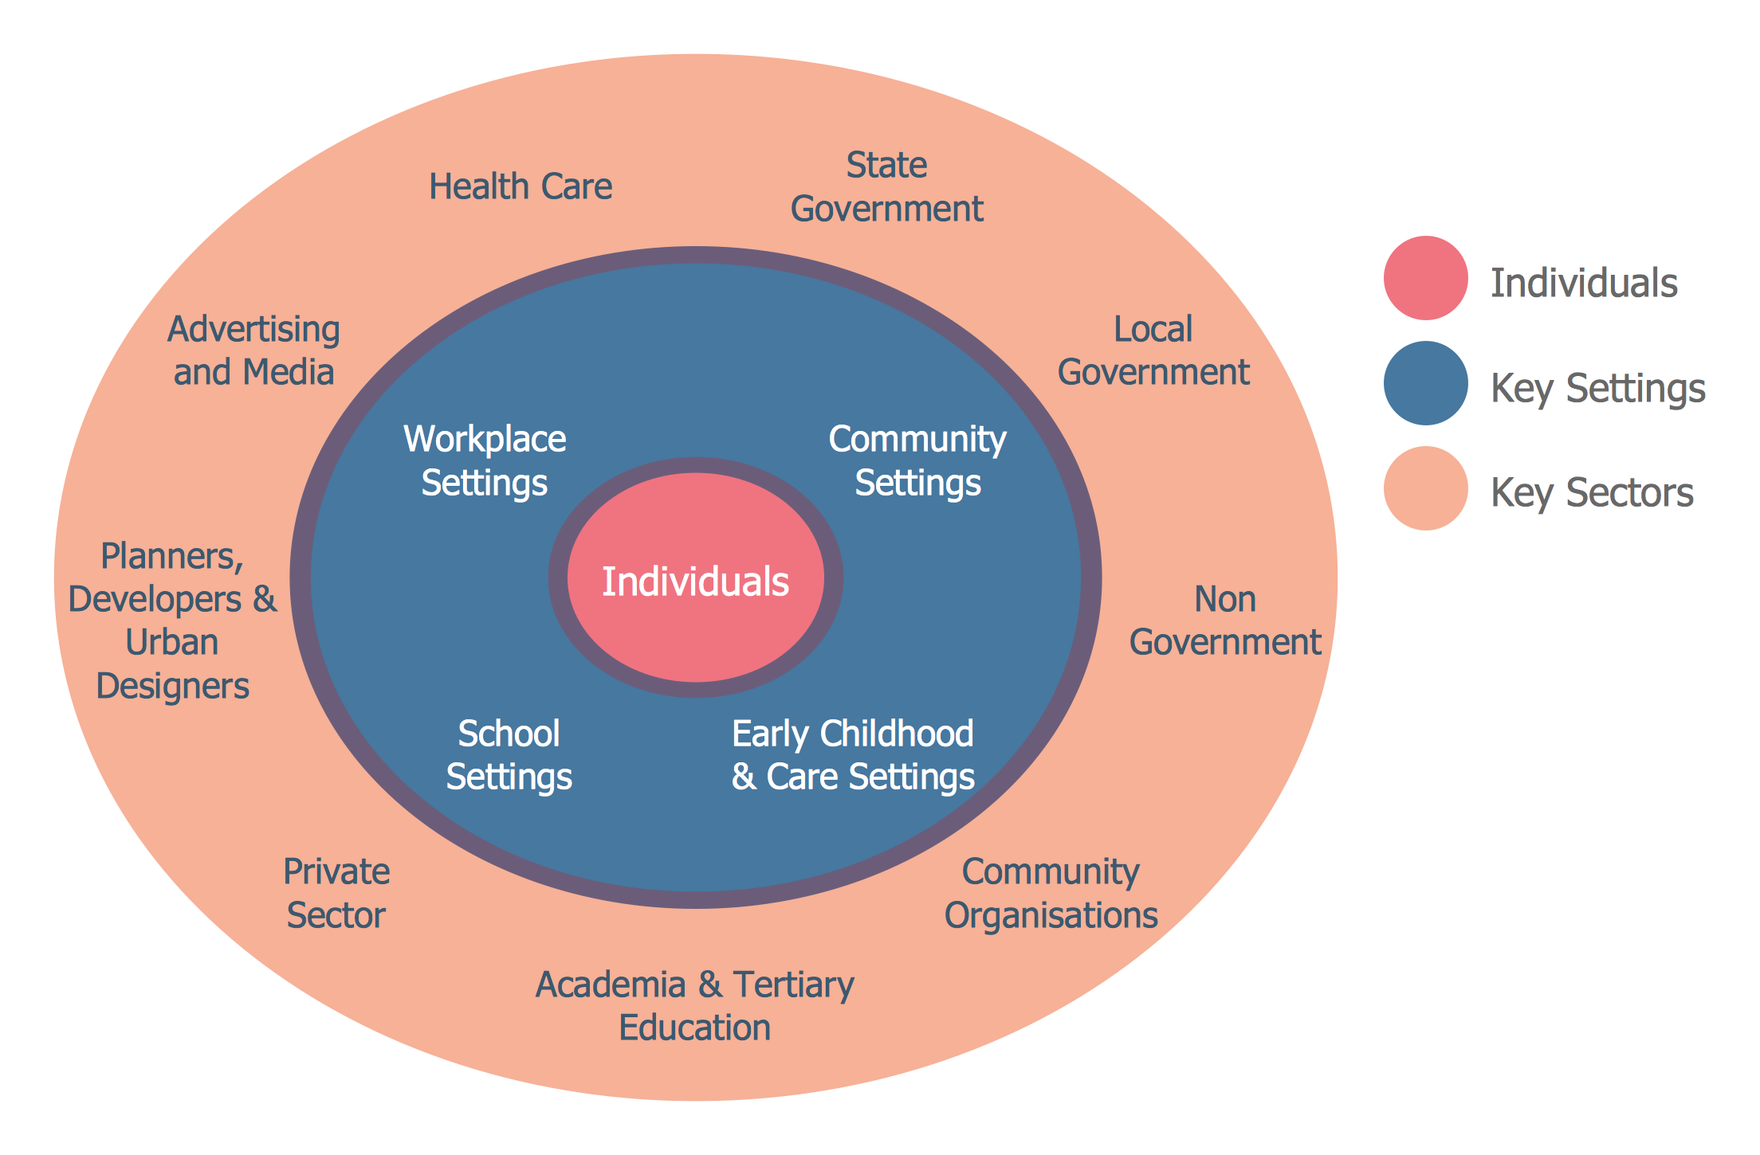
Stakeholder Mapping

Slide 12
USER JOURNEY MAP
Awareness: Women in rural areas become aware of the limited employment opportunities available to them, as well as the cultural and social norms that limit their participation in the workforce
Education and Skills Development: Women in rural areas may seek education and training opportunities to improve their chances of securing formal employment
Job Search: Women in rural areas search for employment opportunities, either through formal channels such as job fairs or online portals, or through informal networks and word-of-mouth

Slide 13
USER JOURNEY MAP
Hiring Process: Women in rural areas face several challenges in the hiring process, including discrimination based on gender, lack of formal qualifications or experience, and limited access to credit and financial resources
On-the-Job Challenges: Once employed, women in rural areas may face additional challenges such as inadequate healthcare facilities and services, and limited access to technology and digital infrastructure
Career Progression: Women in rural areas may face barriers in progressing in their careers, such as lack of opportunities for training and development, and limited access to decision-making power and ownership of property and assets

Slide 14

PRIMARY RESEARCH PLAN

Slide 15
RESEARCH OBJECTIVES
To recommend strategies for addressing the barriers to women's employment in rural India and promoting women's economic empowerment.
To identify the main barriers to women's employment in rural areas, including cultural and social norms, lack of education and training opportunities, and discrimination in the hiring process.
To understand the perspectives of women in rural areas who are seeking employment opportunities and the challenges they face in the hiring process.
To assess the impact of household responsibilities on women's ability to participate in the workforce.
To examine the role of technology and digital infrastructure in promoting women's employment in rural areas.
To assess the impact of government policies and programs for women empowerment and to identify areas for improvement.

Slide 16
RESEARCH METHOD
Observational studies: Observing participants in their natural environment.
Surveys: used to gather data and get large number of insights into the experiences and perspectives of women in rural areas. It can be administered in person, by mail, or online.
Interviews: Interviews can be used to gather detailed information from individual participants related to women's employment in rural India. It can be conducted in person, by phone, or through online platforms as well.
Focus groups: Bringing a small group of participants together to discuss a specific topic and can provide rich insights into the topic.
Case studies: Conducting a detailed investigation which can provide in-depth insights into the challenges faced by women.

Slide 17

SAMPLE SELECTION
Simple Random Sampling: Simple random sampling is a straightforward method of selecting participants from the target population
Stratified Random Sampling: Stratified random sampling is a method of selecting participants that involves dividing the target population into subgroups based on specific characteristics, such as age, education level, or geographic location, and then randomly selecting participants from each subgroup
Convenience Sampling: Convenience sampling is a method of selecting participants that involves recruiting individuals who are easily accessible or willing to participate in the study
Snowball Sampling: Snowball sampling is a method of selecting participants that involves recruiting individuals through their networks or connections

Slide 18
Areas with employment opportunities for rural women
Raigarh – Handicrafts and weaving (textile, basketry and other handicrafts), small scale industries (food processing, agro based, soap making etc.), health and education (teachers, nurses, healthcare workers), self-help groups and micro enterprises etc.
Nashik – Grape and wine industry (Vineyard management, winemaking and exports), food processing and packaging industry, handloom weaving industry (weaving, dyeing and finishing of textiles) etc.
Palghar – Fishing industry (sea food packaging, processing and exports), horticulture, handlooms, manufacturing industries (production, assembly line) etc.
 | Raigarh | Nashik | Palghar
Female Population | 12,89,855 | 29,50,001 | 2,61,652
Working | 3,19,126 | 10,17,042 | 68,369
% | 24.74% | 34.48% | 26.13%
Non-Working | 9,70,729 | 19,32,959 | 1,93,283
% | 75.26% | 65.52% | 73.87%

Slide 19
QUESTIONAIRES
What is your current employment status?
Have you ever been employed in the past?
If yes, what type of work have you done in the past?
What type of employment opportunities are available to women in your community?
Are there any obstacles you face in finding employment in your area?
Are there any specific industries or businesses that you would like to see in your rural community to create job opportunities?
Are there any flexible work arrangements, such as part-time or remote work, that would make it easier for you to maintain employment?
How would having a job impact your daily life and financial situation?
Do you have access to technology and the internet to search and apply for jobs?
Have you faced discrimination or barriers in the job market due to gender, race, or other factors?

Slide 20
QUESTIONAIRE
Are there any specific skills or qualifications that are necessary for women to obtain employment in your community?
What changes do you think are needed to improve employment opportunities for women in rural areas?
In your opinion, what are the benefits of increased women's employment in rural areas?
Have you received any training or education to improve your job skills or employment prospects? If yes, was the training or education provided by the government or the private sector?
Do you think that access to childcare services is a barrier to women's employment in rural
Have you noticed any changes in the employment or entrepreneurship opportunities for women in your community in the last 5 years? If yes, what type of support did you receive and was it helpful in starting your business
Have you ever faced discrimination or harassment in the workplace?
Have you ever attempted to start your own business or become an entrepreneur? If Yes, what challenges did you face in starting your own business ?
Are there any resources or services in your community that would help you overcome these barriers?
Do you think government policies and programs aimed at promoting women's employment in rural areas are effective?

Slide 21

DATA COLLECTION
Questionnaires
Surveys
Interviews
Secondary data sources (existing data)

Slide 22
DATA ANALYSIS
Thematic Analysis: Thematic analysis will be conducted on the qualitative data collected from the in-person interviews, online surveys, focus groups, and observations. This will involve coding the data into themes and patterns related to the barriers to employment
Descriptive Statistics: Descriptive statistics will be used to summarize the demographic characteristics of the sample and to describe the experiences and perspectives of the women on the barriers to employment. This will include measures of central tendency (mean, median, mode) and dispersion (standard deviation) for demographic variables and frequencies for categorical variables related to barriers to employment.
Inferential Statistics: Inferential statistics will be used to test hypotheses about the relationships between variables. For example, a t-test may be used to compare the mean education level of employed women to the mean education level of unemployed women. A chi-squared test may be used to examine the association between access to transportation and employment status
Content Analysis: Content analysis will be conducted on secondary data sources to identify trends and patterns related to the barriers to employment in rural India.
Triangulation: The data collected from multiple sources and methods will be triangulated to increase the validity and reliability of the findings. For example, findings from the in-person interviews will be compared to the findings from the online surveys to ensure that the results are consistent

Slide 23
INTERPRETATION AND REPORTING
Discussion: The discussion will interpret the findings of the study and will provide insights into the experiences and perspectives of the women on the barriers to employment. The discussion will highlight the implications of the findings for policies and programs aimed at addressing the barriers to employment in rural India.
Data Presentation: The data collected from the study will be presented in a clear and concise manner using tables, graphs, and charts. Descriptive statistics will be used to summarize the demographic characteristics of the sample and to describe the experiences and perspectives of the women on the barriers to employment. Inferential statistics will be used to test hypotheses about the relationships between variables.
Findings: The findings from the study will be reported in a clear and concise manner and will focus on the key barriers to women's employment in rural India. The findings will be supported by the data collected from the study and will be compared to the relevant literature.
Recommendations: The study will conclude with recommendations for addressing the barriers to women's employment in rural India. These recommendations will be based on the findings of the study and will be informed by the relevant literature. The recommendations will be targeted at policy-makers, employers, and other stakeholders in the rural areas of India.
Limitations: The study will acknowledge the limitations of the data collected and the methods used. The limitations will be discussed in detail and will provide insights into areas for future research.

Slide 24
Various Initiatives taken to overcome the barriers
The Government of India has several initiatives to address the barriers to women's employment in rural areas, such as the Pradhan Mantri Matru Vandana Yojana and the Mahila Shakti Kendra scheme, aimed at improving the socio-economic status of women and promoting their participation in the workforce.
However, the data shows that the rate of women's employment in rural India still remains low and more efforts needs to be taken to empower them with education, skills, infrastructure, and financial resources and addressing the cultural norms and household responsibilities for rural women's employment.

Slide 25
Thank You
Submitted by:
Harpreet Kaur Khalsa 90
Harshal Malode 94
Navil Bordia 102
Priyanshi Avatani 108
Rahul Bhujade 109
Zaid Panhalkar 130

